Slide 1
Trade&Ahead Investment Consulting
PGP-DSBA _ Trade&Ahead Project
February 29, 2024

Slide 2
Contents / Agenda
Executive Summary
Business Problem Overview
Solution Approach
EDA Results
Data Preprocessing
K-Means Clustering
Hierarchical Clustering
Appendix

Slide 3
Executive Summary
Considering execution time, relative clustering performance measured, and number of clusters, K-Means 4 cluster option appears to be a preferable choice to the clusters obtained using hierarchical clustering
Investment in KM_Segment 1 appears to be a safe bet considering the associated low to moderate current price of shares and high earnings per share; however, the benefits should be weighed against the relatively low to moderate ROE and Cash Ratio
KM_Segment 2 also has a low to moderate price and thus relatively affordable shares. However, compared to earnings, the stocks might be considered expensive due to the high P/E ratio. Moreover, the low Cash Ratio and Earnings Per Share might be further reason to be careful about investment in this cluster
KM_Segment 3 is characterized by high Current Price, Price Change, and P/B ratio. These characteristics render investment in this cluster expensive and risky. Though the Cash Ratio is high, the related benefit should be measured against the low ROE that characterizes the cluster.
KM_Segment 3 is a low-risk, low-return cluster since all the reported metrics are low to moderate. It would be advisable for an investor to make minimal investment in this sector, if interested; however, the investment should be spread across several companies to further take advantage of the low-risk that characterizes the cluster

Slide 4
Business Problem Overview
For several years now, investing in the stock market has demonstrably proven to be a good investment option
Portfolio diversification is a critical consideration when contemplating or analyzing the purchase of stocks; on average, diversification reduces investment risk
Several financial metrics characterize securities in the stock market and influence the profitability of investments
I have been hired by Trade&Ahead, a financial consultancy firm, to help analyze some collected data on stock price and related financial metrics for a number of companies listed under the New York Stock Exchange
The analysis comprises grouping the stocks using available attributes, providing insights on group characteristics and, thus, helping Trade&Ahead provide personalized investment guidance to its clients

Slide 5
Solution Approach
Steps taken to accomplish the task:
General Analysis of the data to uncover information such as shape, data types, and statistical summary
Exploratory Data Analysis to explore the distributions of individual attributes as well as interaction between their respective variables
Data Preprocessing, specifically scaling using the Standard Scaler, in preparation for clustering using various cluster algorithms
Use of K-means and Hierarchical clustering to group the stocks into several number of clusters and evaluating the clusters using the Elbow Plot and Silhouette Scores for K-means and Dendrograms and Cophenetic Correlation for Hierarchical clustering
Finally, exploration of chosen clustering options and uncovering of insights such as the sizes and constitution of the clusters and the performance of the provided metrics across the clusters

Slide 6
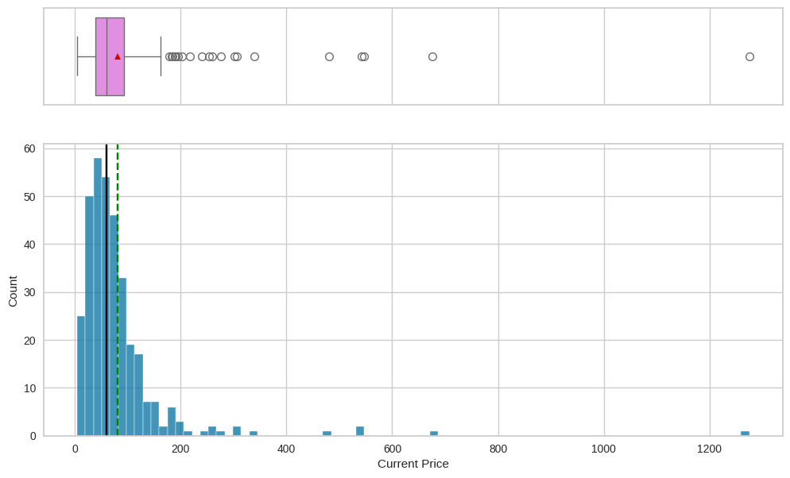
EDA Results: Univariate Analysis: Current Price
We have confirmation that the distribution of Current Price is right-skewed with several upper outliers
The mean, about 80, is 20 greater than the median
Link to Appendix slide on data background check

Slide 7
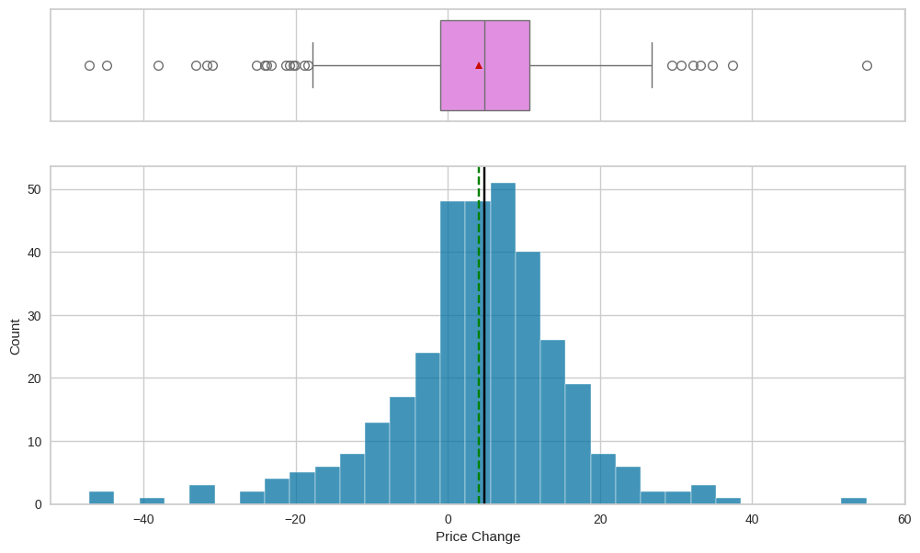
EDA Results: Univariate Analysis: Price Change
Price Change is left-skewed but slightly symmetrical with several outliers on both ends of the distribution
The mean, 4, is 1 lower than the median
Link to Appendix slide on data background check

Slide 8
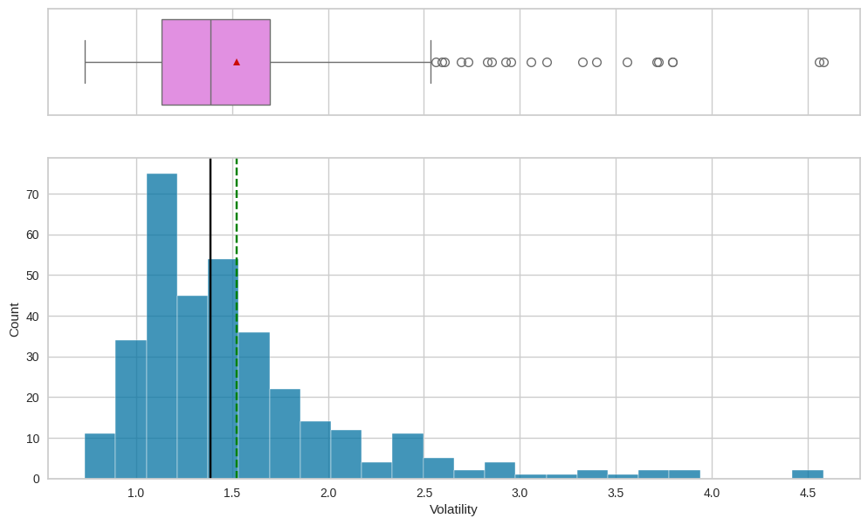
EDA Results: Univariate Analysis: Volatility
Volatility is heavily right-skewed with several upper outliers
The mean, about 1.5, is approximately 0.16 greater than the median
Link to Appendix slide on data background check

Slide 9
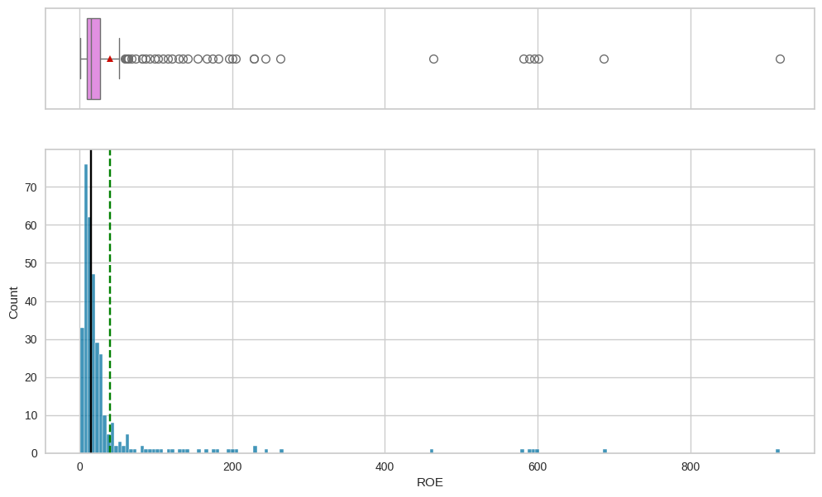
EDA Results: Univariate Analysis: ROE
The ROE is heavily right-skewed with several upper outliers
The mean, 40, is 25 greater than the median
Link to Appendix slide on data background check

Slide 10
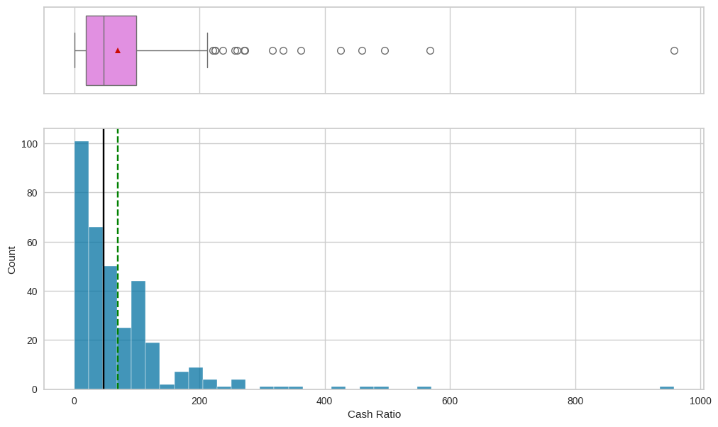
EDA Results: Univariate Analysis: Cash Ratio
The cash ratio is right-skewed with several upper outliers
The mean, 70, is 23 greater than the median
Link to Appendix slide on data background check

Slide 11
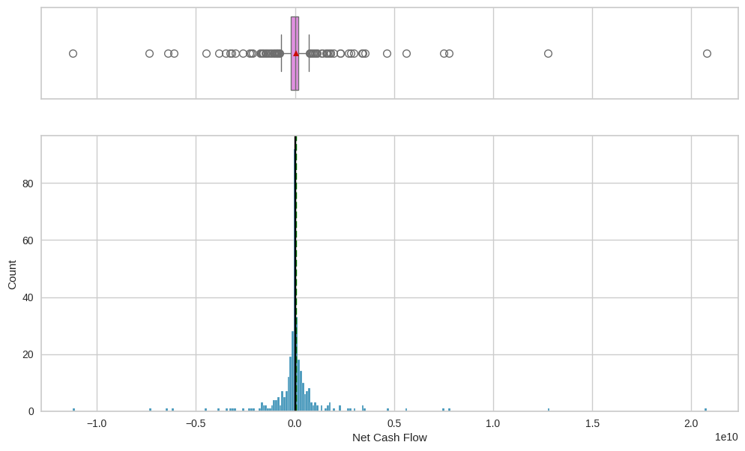
EDA Results: Univariate Analysis: Net Cash Flow
Though the mean of the Net Cash Flow is about 56 M and the median about 2 M, the distribution is approximately normal with several outliers on both sides
Link to Appendix slide on data background check

Slide 12
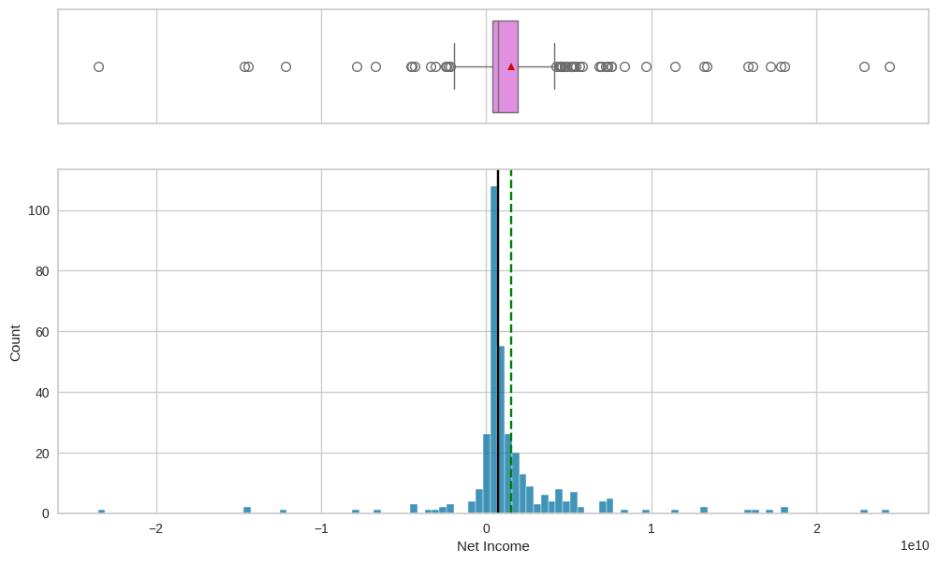
EDA Results: Univariate Analysis: Net Income
The distribution of Net Income displays some level of symmetry but is right-skewed and has several outliers on both sides of the distribution
The mean, about 1.5 B is approximately twice the median, about 700 M
Link to Appendix slide on data background check

Slide 13
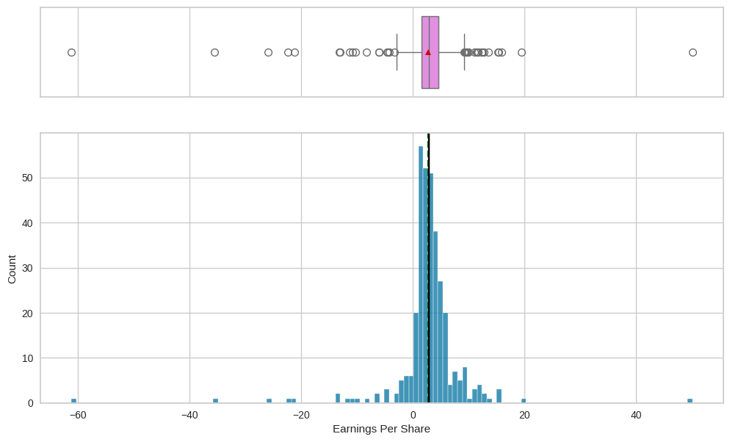
EDA Results: Univariate Analysis: Earnings Per Share
The Earnings Per Share is approximately normal with several outliers on both sides of the distribution
The mean, 2.8, is just about 0.1 less than the median
Link to Appendix slide on data background check

Slide 14
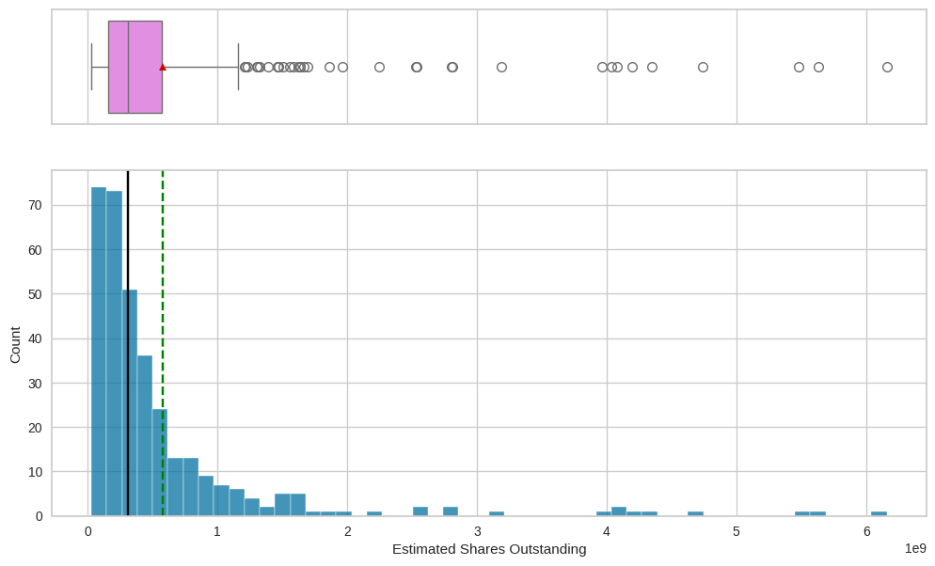
EDA Results: Univariate Analysis: Estimated Shares Outstanding
The Estimated Shares Outstanding is right-skewed with several upper outliers
The mean, about 580 M, is greater than the median, about 310 M
Link to Appendix slide on data background check

Slide 15
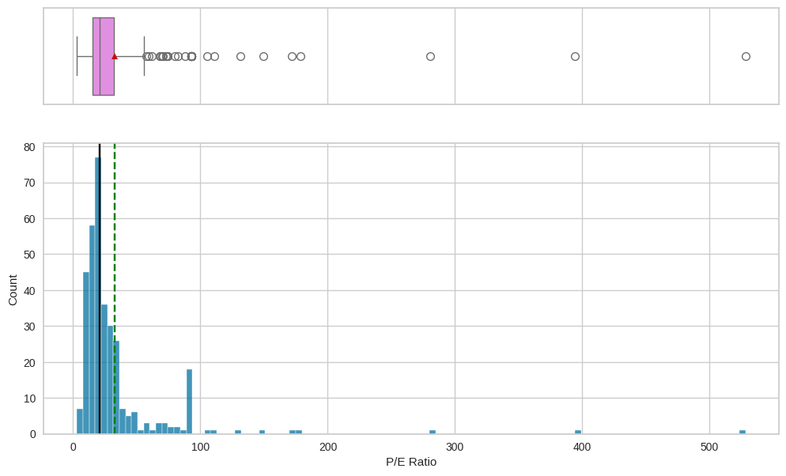
EDA Results: Univariate Analysis: P/E Ratio
The P/E Ratio is heavily right-skewed with several upper outliers
Peak observed between 80 and 100
The mean, about 33, is approximately 12 greater than the median
Link to Appendix slide on data background check

Slide 16
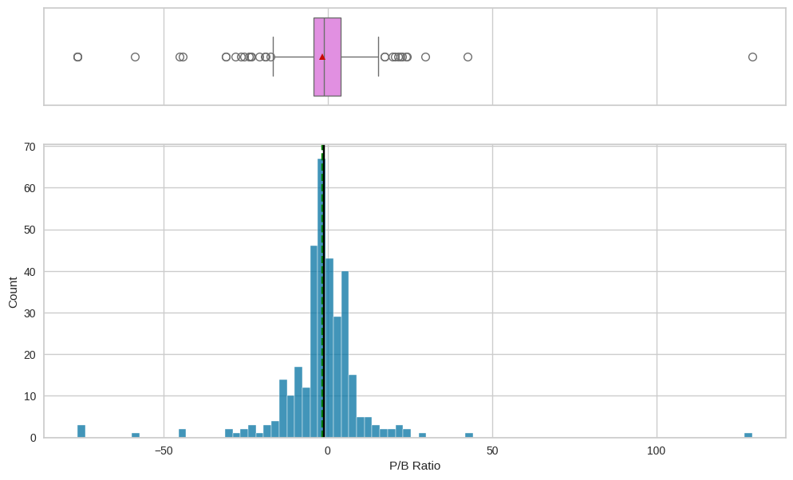
EDA Results: Univariate Analysis: P/B Ratio
The P/B Ratio is approximately normally distributed with several outliers on both sides of the distribution
The mean, about -2, is 1 less than the median
Link to Appendix slide on data background check

Slide 17
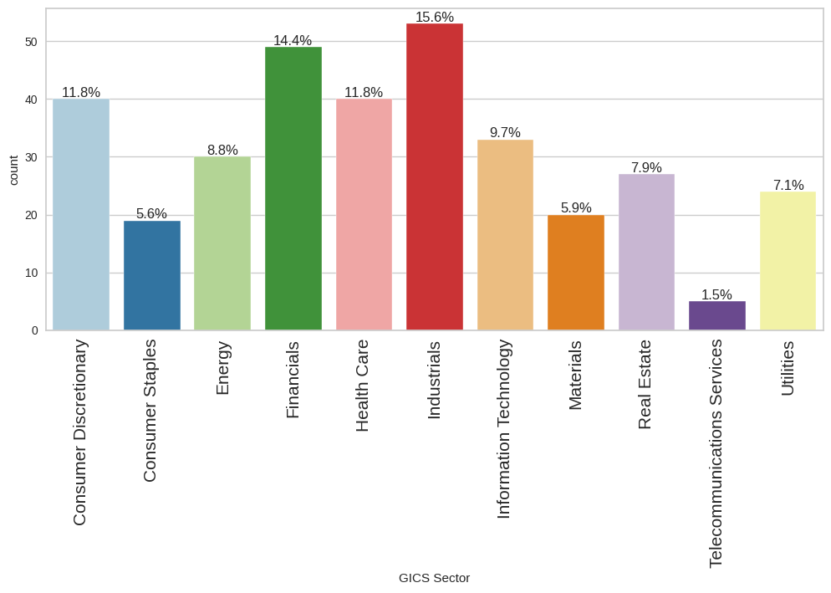
EDA Results: Univariate Analysis: GICS Sector
Industrials, at 15.6%, constitute the most popular GICS Sector, followed but Financials (14.4%), Consumer Discretionary and Health Care (11.8% each)
Telecommunications Services constitute the least popular sector (1.5%)
Link to Appendix slide on data background check

Slide 18
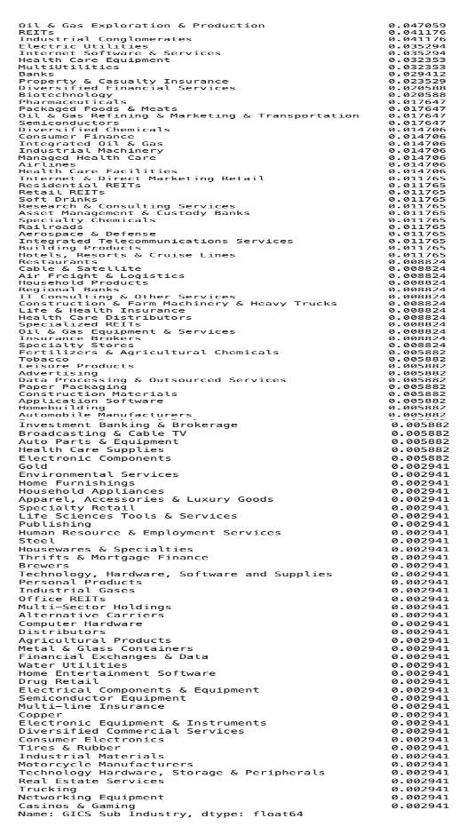
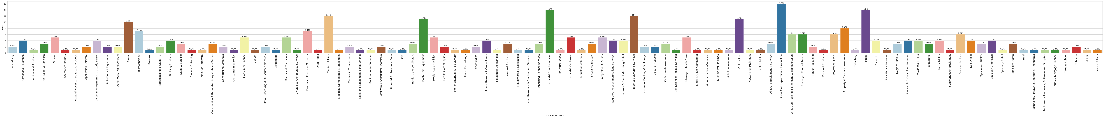
EDA Results: Univariate Analysis: GICS Sub Industry
Oil & Gas Exploration & Production (4.7%) is the most popular GICS Sub Industry followed by REITs and Industrial Conglomerates (4.1% each)
42 GICS Sub Industries occupy the lowest rank of popularity (0.3% each)
Link to Appendix slide on data background check

Slide 19
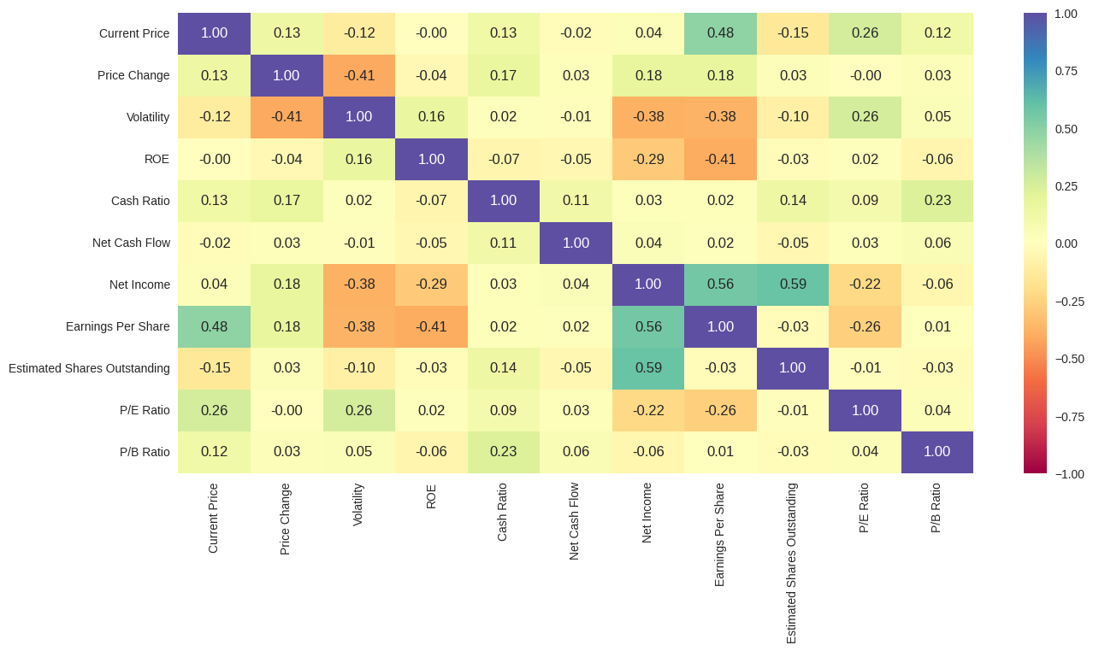
EDA Results: Bivariate Analysis: Correlation Check
A fair amount of positive correlation is observed between Net Income on the one hand and Earnings Per Share and Estimated Shares Outstanding on the other; a little less between Earnings Per Share and Current Price
Weaker negative correlations are observed between Volatility on the one hand and Net Income and Earnings Per Share on the other, between Price Change and Volatility, and between ROE and Earnings Per Share
Link to Appendix slide on data background check

Slide 20
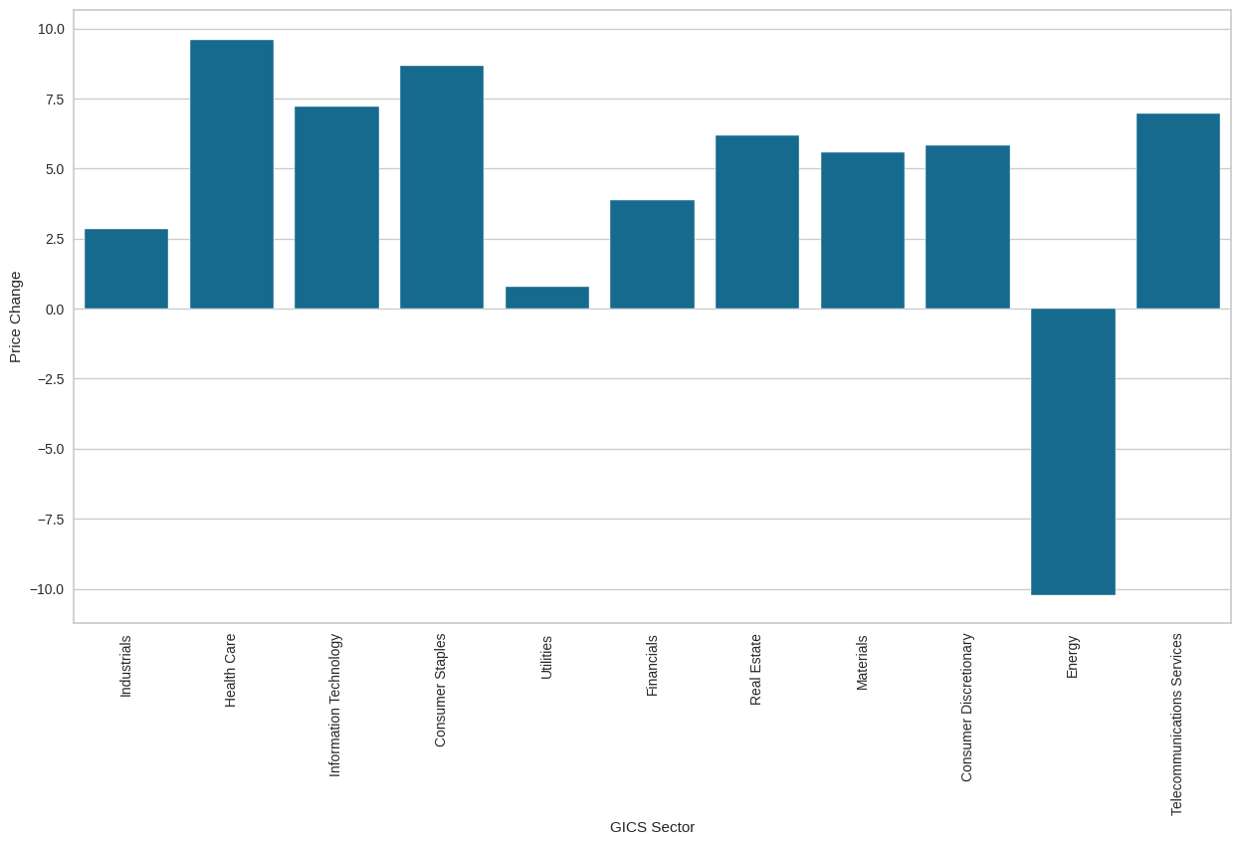
EDA Results: Bivariate Analysis: Price Change vs GICS Sector
Health Care registered the highest percentage price increase in 13 weeks followed by Consumer Staples and then Information Technology
Energy is the only GICS Sector that registered a percentage price decrease
Link to Appendix slide on data background check

Slide 21
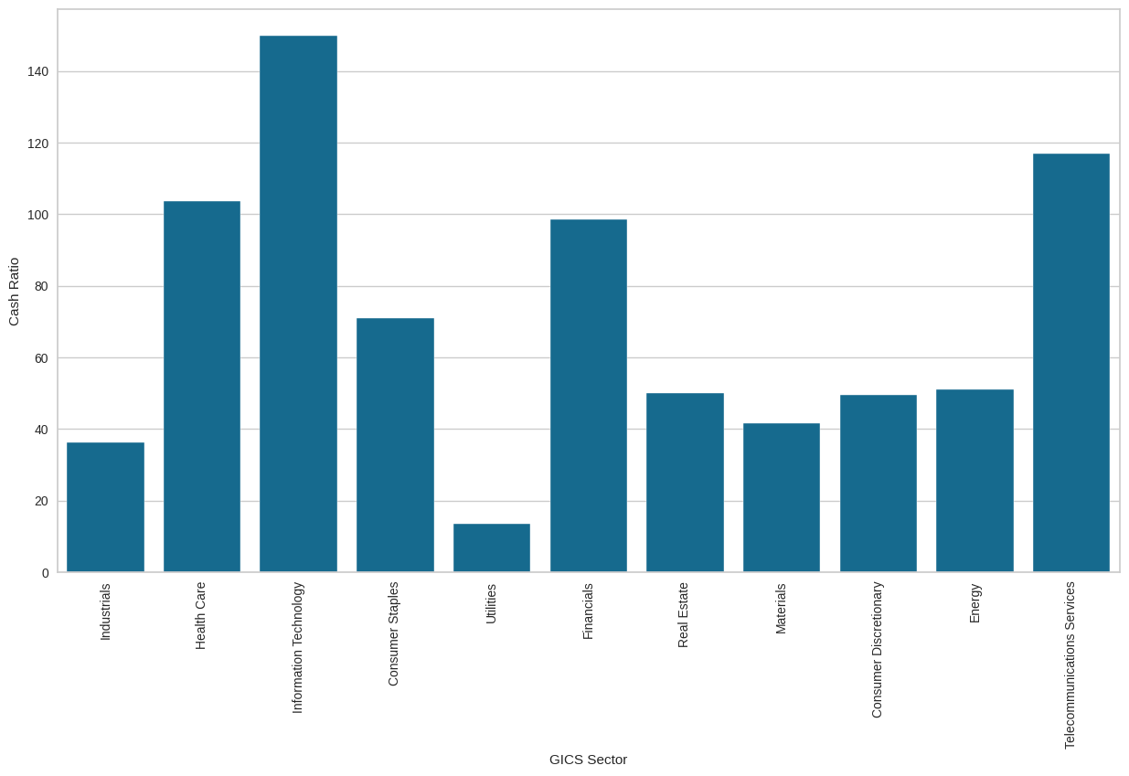
EDA Results: Bivariate Analysis: Cash Ratio vs GICS Sector
The highest cash ratio was registered for Information technology (between 140 and 160) followed by Telecommunications Services (between 110 and 120), Health Care (between 100 and 110), and Financials (between 90 and 100)
The lowest cash ratio was registered for Utilities (about 10) followed by Industrials (between 30 and 40)
Link to Appendix slide on data background check

Slide 22
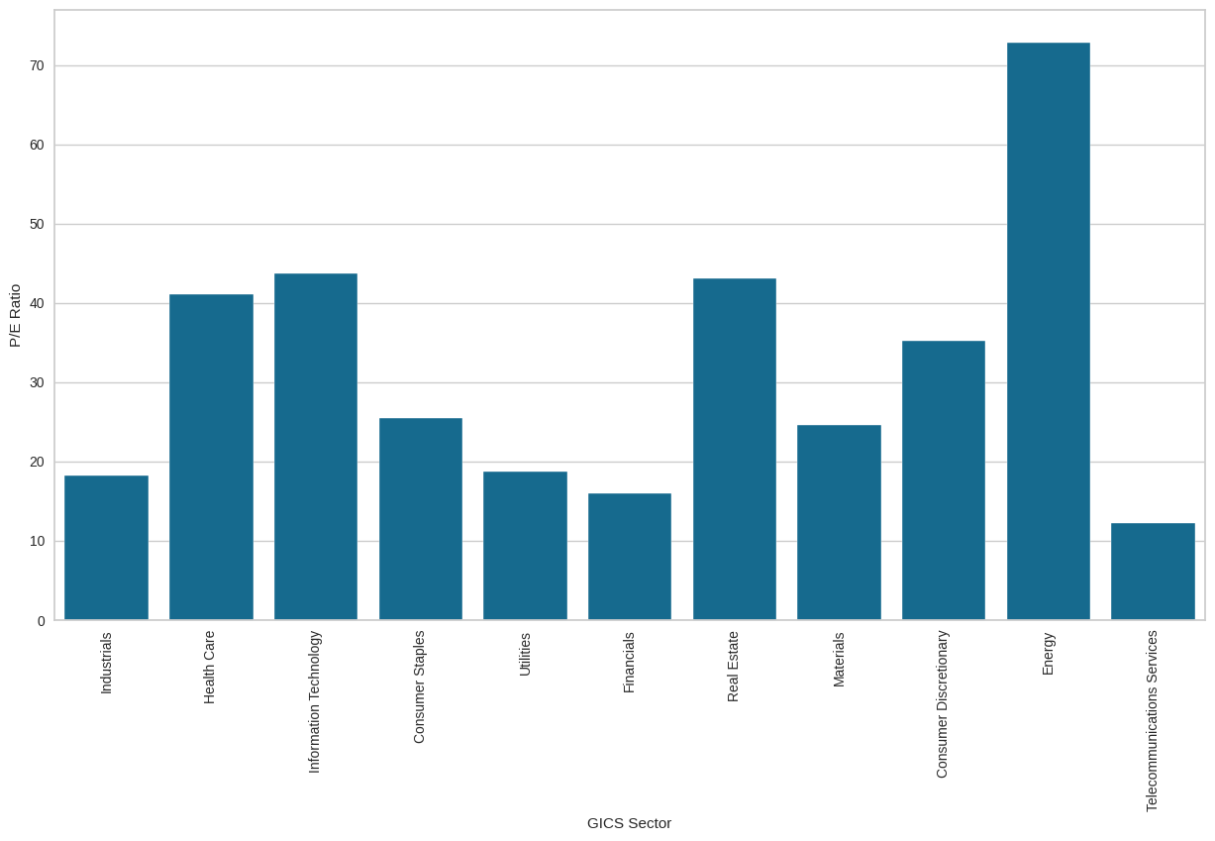
EDA Results: Bivariate Analysis: P/E Ratio vs GICS Sector
Energy, the only GICS Sector that registered a percentage price decrease, has, by far, the highest P/E Ratio (over 70) followed by Real Estate, Information Technology, and Health Care (each between 40 and 45)
Telecommunications Services registered the lowest P/E Ratio (between 10 and 15)
Link to Appendix slide on data background check

Slide 23
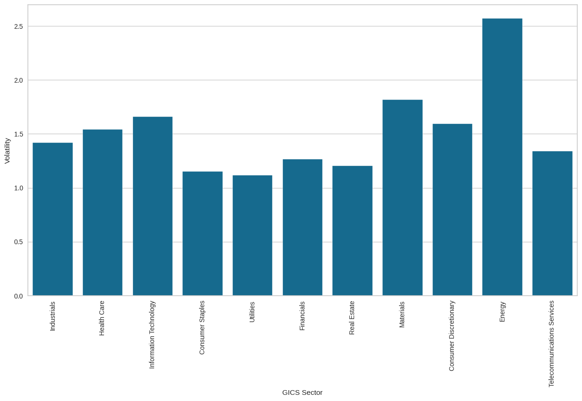
EDA Results: Bivariate Analysis: Volatility vs GICS Sector
Once again, Energy enjoys the top position with a volatility rating of over 2.5 followed by Materials (between 1.75 and 2.0) and Information Technology, Consumer Discretionary, and Health Care (all between 1.5 and 1.75)
The lowest ranks are occupied by Utilities, Consumer Staples, and Real Estate (each between 1.0 and 1.25) followed by Financials (about 1.25) and Telecommunications Services (between 1.25 and 1.5)
Link to Appendix slide on data background check

Slide 24
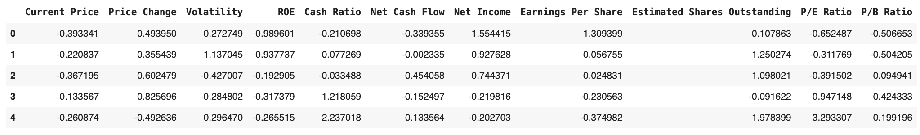
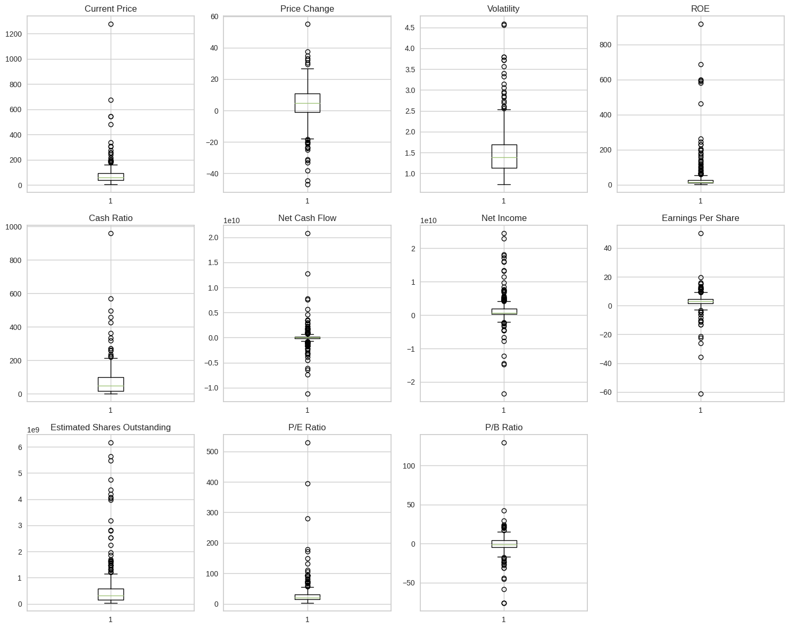
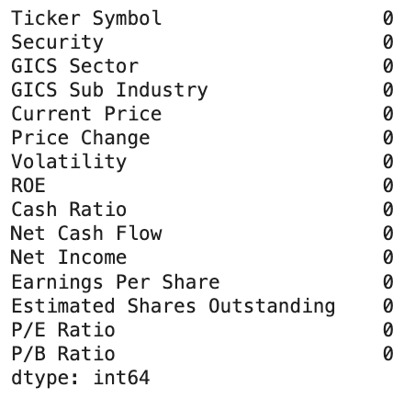
Data Preprocessing
The data contains no missing values
No duplicates
All the numerical columns contain outliers
The scaled dataset contains comparable values across columns, ready for effective clustering while avoiding large value columns from skewing the clustering models

Slide 25
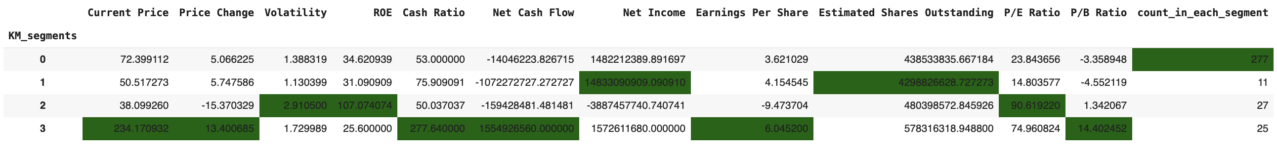
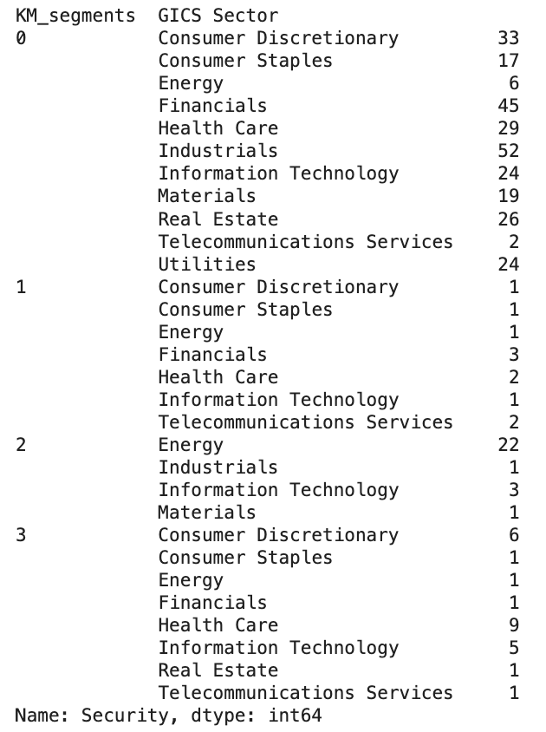
K-Means Clustering Summary: Cluster Profiling (1/2)
KM_Segment 0 has the greatest number of companies whereas Cluster 1 has the least
KM_Segment 1 has the greatest average Net Income and Estimated Shares Outstanding
KM_Segment 2 has the greatest Volatility, ROE, and P/E Ratio
KM_Segment 3 has the greatest Current Price, Price Change, Cash Ratio, Net Cash Flow, Earnings Per Share, and P/B Ratio
It appears KM_Segment 0 comprises of the majority of companies with relatively low financial metrics while the other 3 KM Segments constitute, each, of relatively few companies with high financial performance, demonstrated via diverse metrics
KM_Segment 0 has the largest number of GICS Sectors (11) followed by KM_Segment 3 (8) and KM_Segment 1 (7); KM_Segment 2 contains the least number of GICS Sectors (4)
Telecommunications Services are spread across KM Segments 0, 1, and 3
Consumer Discretionary is most represented in KM_Segment 0 and least in KM_Segment 2 where is has no representation at all, same with Financials, Consumer Staples, and a couple other sectors
Utilities are only found in KM_Segment 0
KM Segments 1, 2, and 3 contain some well known big players such as Coca Cola, Pfizer, Ford Motor, Yahoo, Facebok, and some Oil And Gaz Companies
Link to Appendix slide on K-Means Clustering

Slide 26
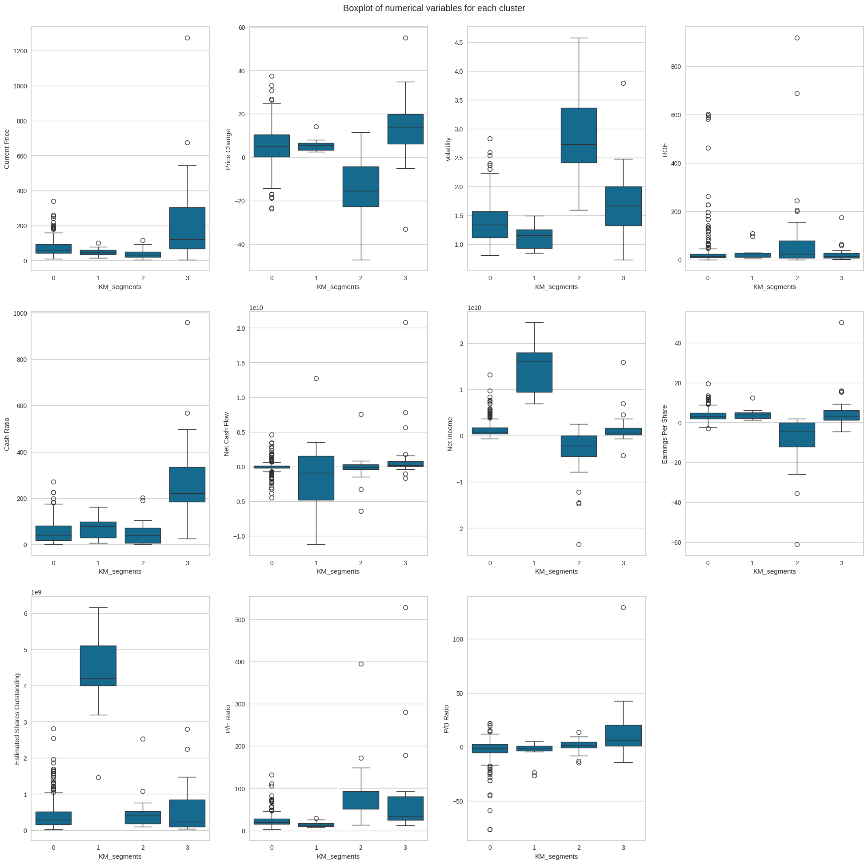
K-Means Clustering Summary: Cluster Profiling (2/2)
KM Segments 1, 2, and 3 contain some well known big players such as Coca Cola, Pfizer, Ford Motor, Yahoo, Facebok, and some Oil And Gaz Companies
The boxplots confirm the information obtained from the profile highlight
In addition, signification variation is observed in Current Price, Cash Ratio, P/E Ratio, and P/B Ratio for KM_Segment 3, Price Change, Volatility, ROE, and Earnings Per Share for KM_Segment 2, and Net Cash Flow, Net Income, and Estimated Shares Outstanding for KM_Segment 1
KM_Segment 0
Has 277 companies
Low Current Price, Volatility, and Cash Ratio
Moderate to high Price Change
Low ROE
Moderate Net Cash Flow, Net Income, and Earnings Per Share
Low Estimated Shares Outstanding, P/E Ratio, and P/B Ratio
KM_Segment 1
11 companies
Low to moderate Current Price
Moderate Price Change
Low to moderate Current Price, ROE, and Cash Ratio
Low Volatility, P/E Ratio, and P/B Ratio
Low but varied Net Cash Flow
High and varied Net Income
Relatively High Earnings Per Share
High and varied Estimated Shares Outstanding
KM_Segment 2
27 companies
Low Current Price, Cash Ratio, Net Income, and Estimated Shares Outstanding
Low and varied Price Change and Earnings Per Share
High and varied Volatility
Relatively high and varied ROE
Low to moderate Current Price
Medium Net Cash Flow and P/B Ratio
High P/E Ratio
KM_Segment 3
25 companies
High and varied Current Price, Price Change, Cash Ratio, and P/B Ratio
Medium Volatility, Net Income, and Earnings Per Share
Low ROE
High Net Cash Flow
Low and varied Estimated Shares Outstanding
Medium and varied P/E Ratio
Link to Appendix slide on K-Means Clustering

Slide 27
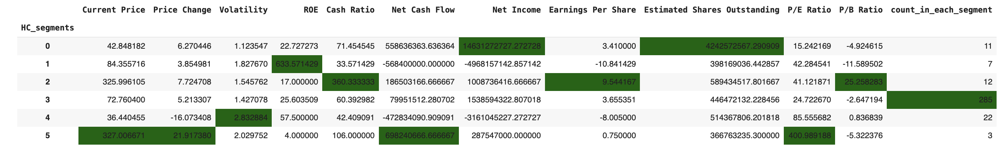
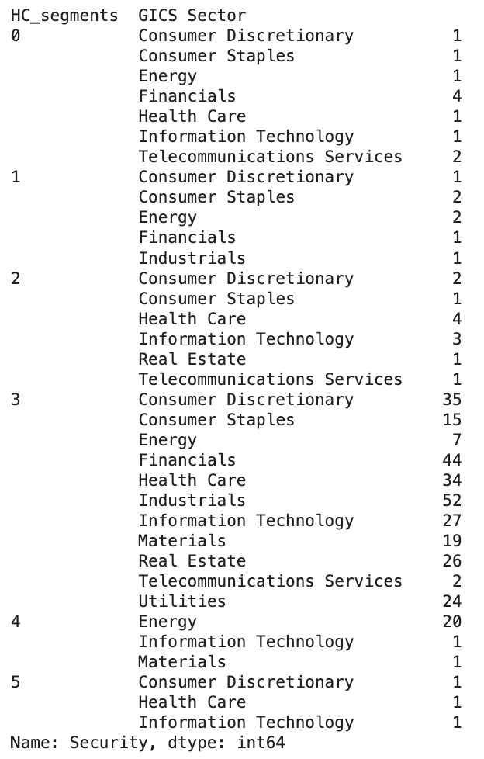
Hierarchical Clustering Summary: Cluster Profiling (1/2)
HC_segment 0 registered the highest Net Income and Estimated Shares Outstanding
HC_segment 1 registered the highest ROE
HC_segment 2 registered the highest Cash Ratio, Earnings Per Share, and P/B Ratio
HC_segment 3 contains the greatest number of companies (285) but is not outstanding in any of the financial metrics - the large majority of average companies
HC_segment 4 registered the highest Volatility
HC_segment 5 registered the highest Current Price, Price Change, Net Cash Flow, and P/E Ratio but contains the lowest number of companies (3) - clearly a segment of elite companies
HC_Segment 3 contains the greatest number of GICS Sectors
Telecommunications Services, Information Technology, Consumer Discretionary, and a few other GICS Sectors are spread oveer several HC Segments
Real Estate is found only in HC Segments 2 and 3
Materials are only found in HC Segments 3 and 4
Utilities are only found in HC Segments 3
Link to Appendix slide on Hierarchical Clustering

Slide 28
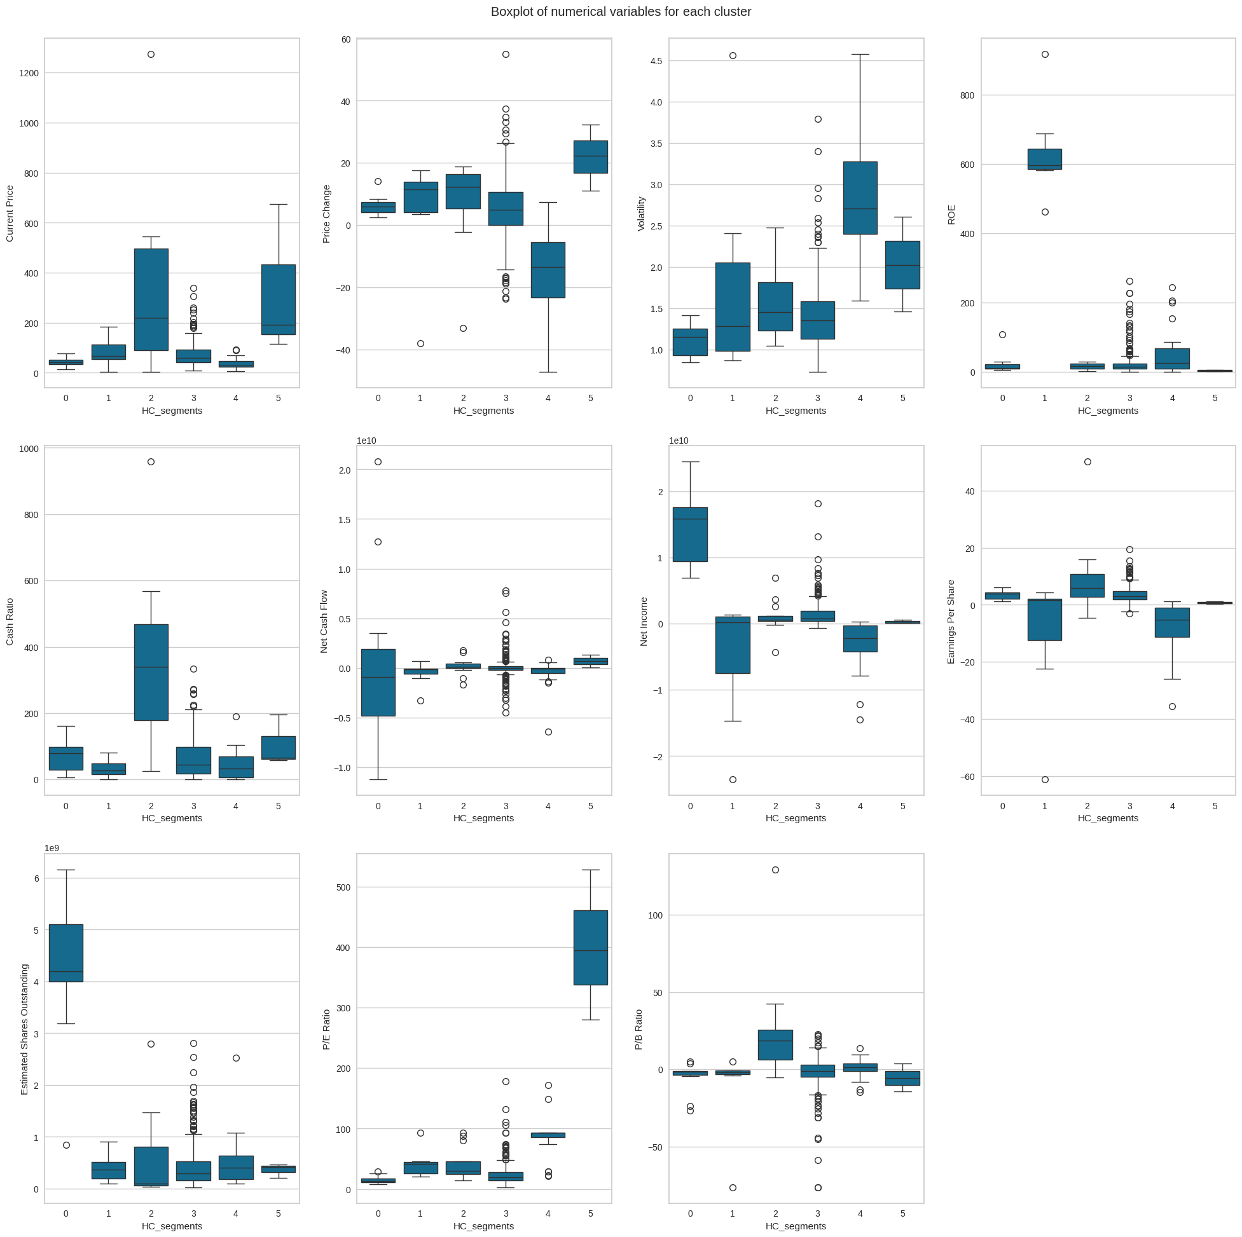
Hierarchical Clustering Summary: Cluster Profiling (2/2)
HC_Segment 0
Has 11 companies
Low Current Price, Volatility, ROE, and P/E Ratio
Medium Price Change, Earnings Per Share, and P/B Ratio
Low to medium Cash Ratio
Low and varied Net Cash Flow
High and varied Net Income and Estimated Shares Outstanding
HC_Segment 1
Has 7 companies
Medium Current Price, Price Change, Net Cash Flow, Estimated Shares Outstanding, P/E Ratio, and P/B Ratio
Low Volatility and Cash Ratio
High ROE
Medium and varied Net Income and Earnings Per Share
HC_Segment 2
Has 12 companies
High and varied Current Price, Cash Ratio, and P/B Ratio
Medium Price Change, Volatility, Net Cash Flow, Net Income, and P/E Ratio
Low ROE
High Earnings Per Share
Low and varied Estimated Shares Outstanding
HC_Segment 3
Has 285 companies
Low to medium Current Price and Estimated Shares Outstanding
Medium Price Change, Volatility, Cash Ratio, Net Cash Flow, Net Income, Earnings Per Share, and P/B Ratio
Low ROE and P/E Ratio
HC_Segment 4
Has 22 companies
Low Current Price, Cash Ratio, Net Income, and Earnings Per Share
Low and varied Price Change
High and varied Volatility
Medium and varied ROE
Medium Net Cash Flow, Estimated Shares Outstanding, P/E Ratio, and P/B Ratio
HC_Segment 5
Has 3 companies
Medium to high Current Price and Volatility
High Price Change
Medium Net Income, Cash Ratio, and Earnings Per Share
Low ROE and P/B Ratio
Relatively high Net Cash Flow
Low to medium Estimated Shares Outstanding
High and varied P/E Ratio
Link to Appendix slide on Hierarchical Clustering

Slide 29
APPENDIX

Slide 30
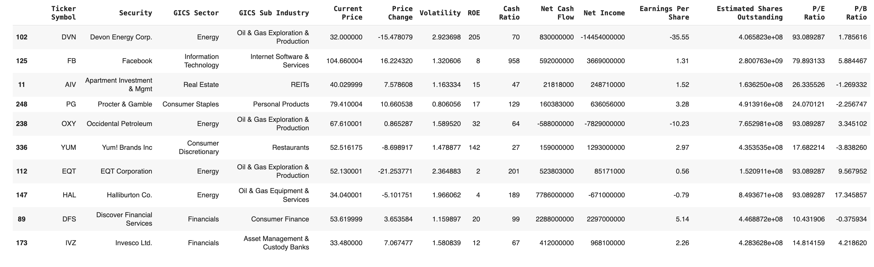
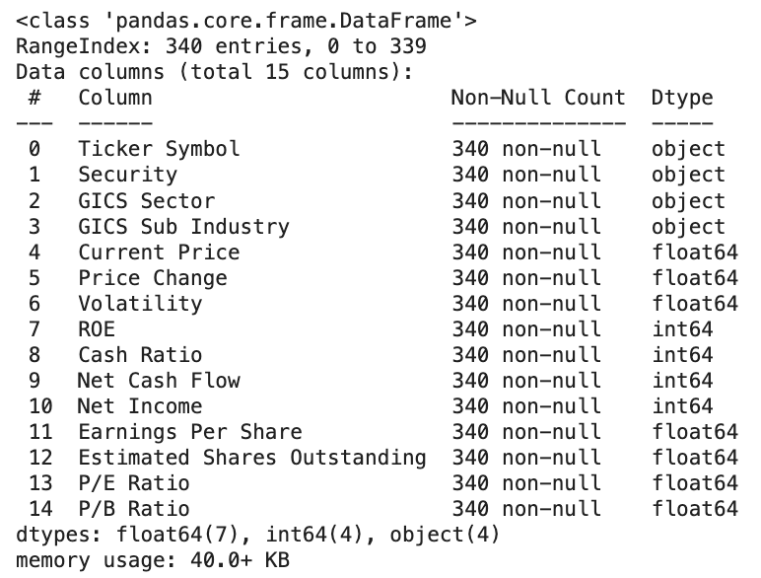
Data Background and Contents: Data Types and Sample display
There are 340 rows and 15 columns
The data appears to have 4 categorical columns and 11 numerical columns
Negative price changes indicate decrease in stock price over the previous 13 weeks
Negative net cash flow, net income, and earnings per share indicate, respectively, net cash outflow, total expenses, interest, and taxes greater than revenues, net loss by the respective companies
Negative P/B ratios indicate that the companies have more liabilities than assets
We have confirmation that the data contains 4 categorical columns and 11 numerical (7 float and 4 int) columns
No obvious missing values

Slide 31
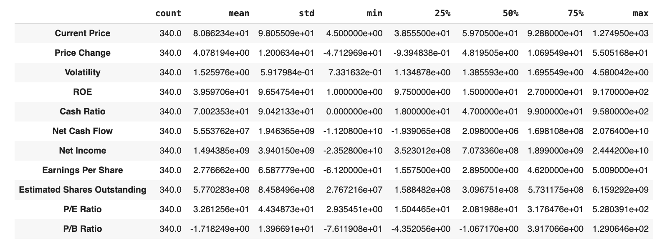
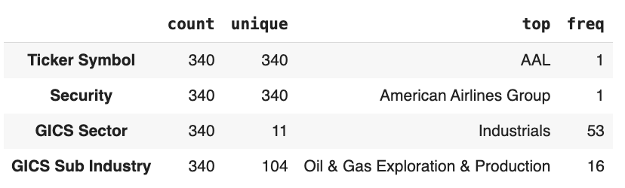
Data Background and Contents: Statistical Summary
Only Price Change, Net Cash Flow, and Net Income, Earnings Per Share, and P/B Ratio contain negative values; these are acceptable scenarios
The means of Current Price, Volatility, ROE, Cash Ratio, Net Cash Flow, Net Income, Estimated Shares Outstanding, and P/E Ratio are greater than their respective medians, indicating that these variables might be right-skewed
The means of Price Change, Earnings Per Share, and P/B Ratio are less than their respective medians, indicating that these variables might be left-skewed
Comparing the minimum values, first quartile, median, third quartile, and maximum values, we expect the data to contain some outliers
Ticker Symbol and Security each have 340 unique values while GICS Sub Industry and GICS Sector respectively have 104 and 11 distinct values
The mode of GICS Sub Industry is "Oil & Gas Exploration & Production" whereas that of GICS Sector is "Industrials"

Slide 32
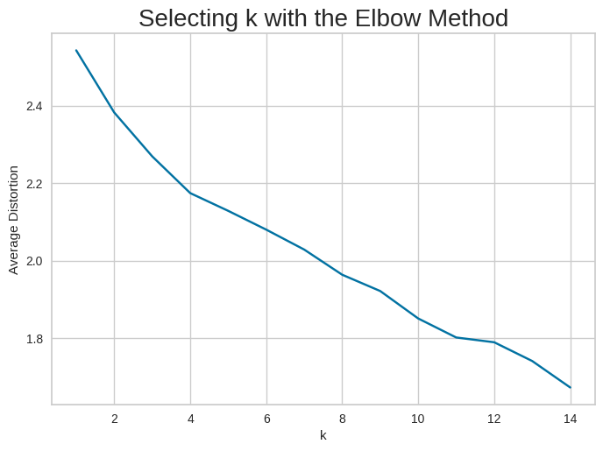
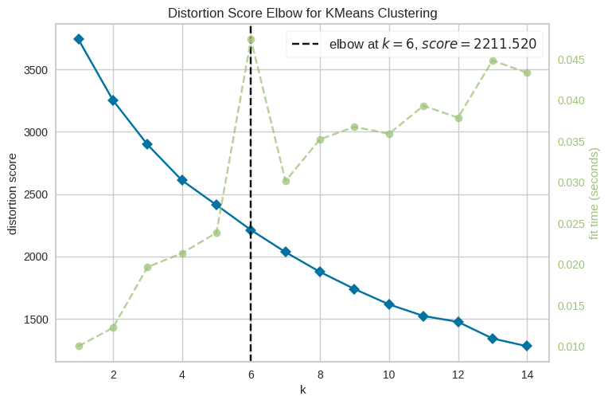
K-Means Clustering Technique: Checking Elbow Plot
From the elbow curve, 2, 4, and 11 appear to be good candidates for k, the number of clusters
The KElbowVisualizer of the yellowbrick.cluster library suggests an elbow at k=6 with a fit time of about 50 ms

Slide 33
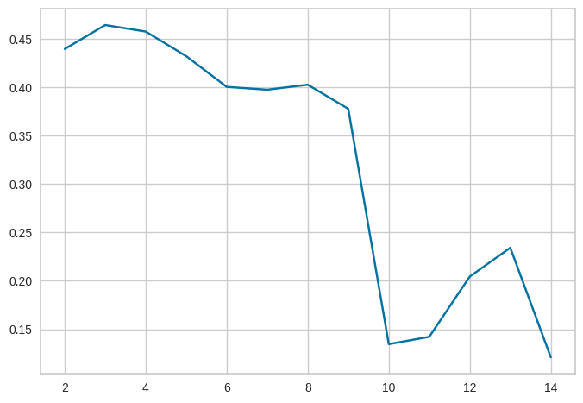
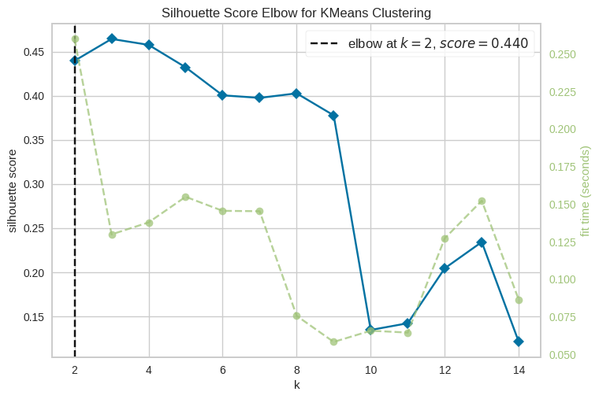
K-Means Clustering Technique: Silhouette Scores (1/2)
The greatest silhouette score is registered for 3 clusters followed by 4 then 2 clusters
Using the silhouette metric, the KElbowVisualizer of the yellowbrick.cluster library suggests an elbow at k=2 with a score of 0.44 and a fit time of about 260 ms

Slide 34
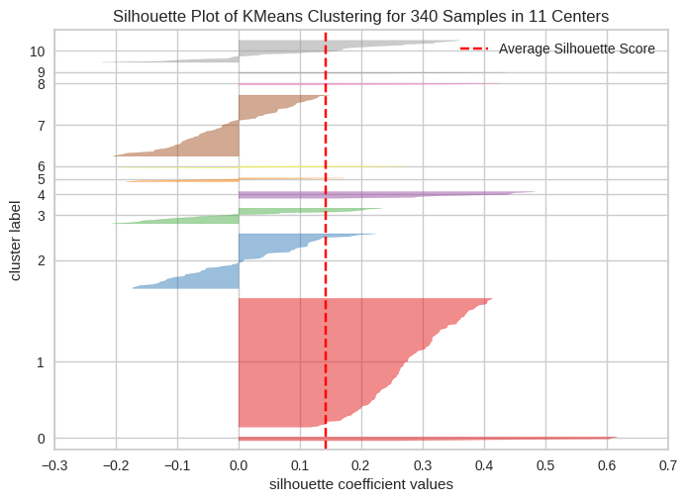
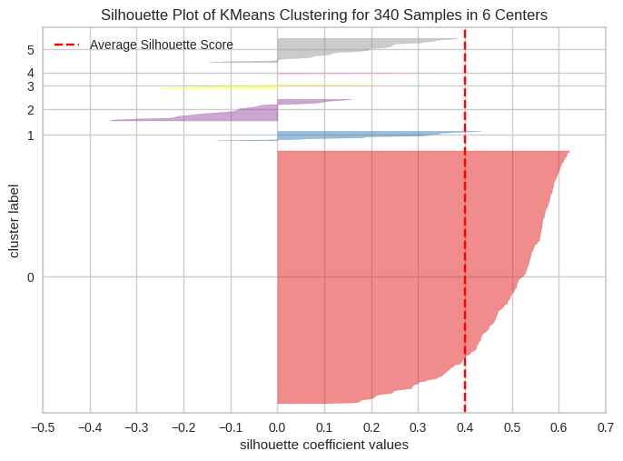
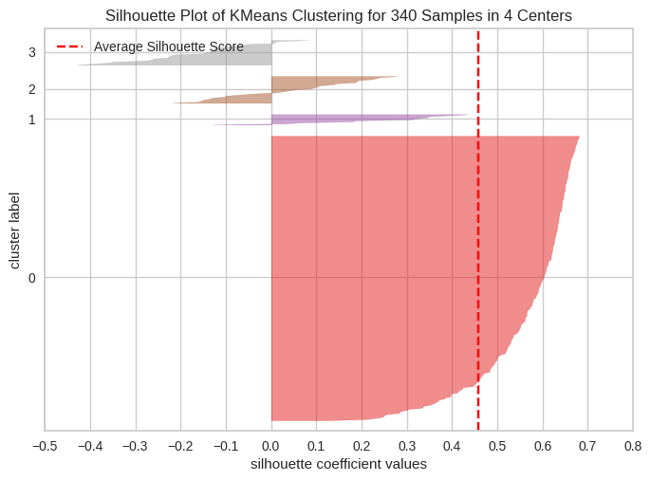
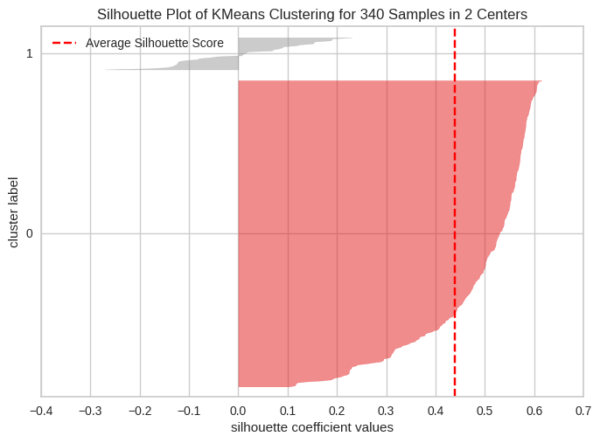
K-Means Clustering Technique: Silhouette Scores (2/2)
We will be choosing 4 as the appropriate number of clusters since it has a relatively high silhouette score (about 0.46) and there is a knick in the elbow curve at k=4

Slide 35
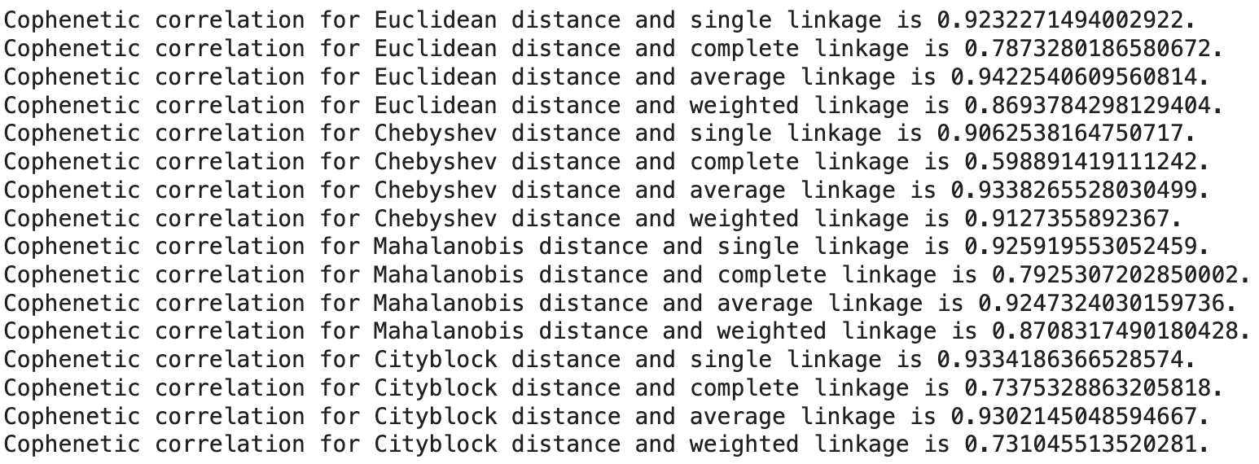
Hierarchical Clustering Technique: Cophenetic Correlation (1/2)
Highest cophenetic correlation is 0.94, which is obtained with Euclidean distance and average linkage

Slide 36
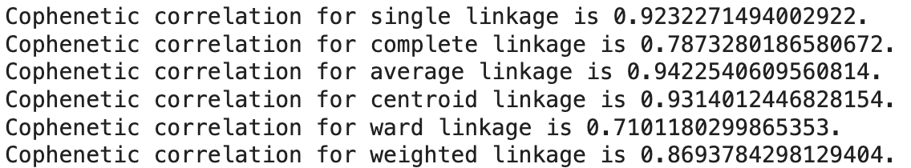
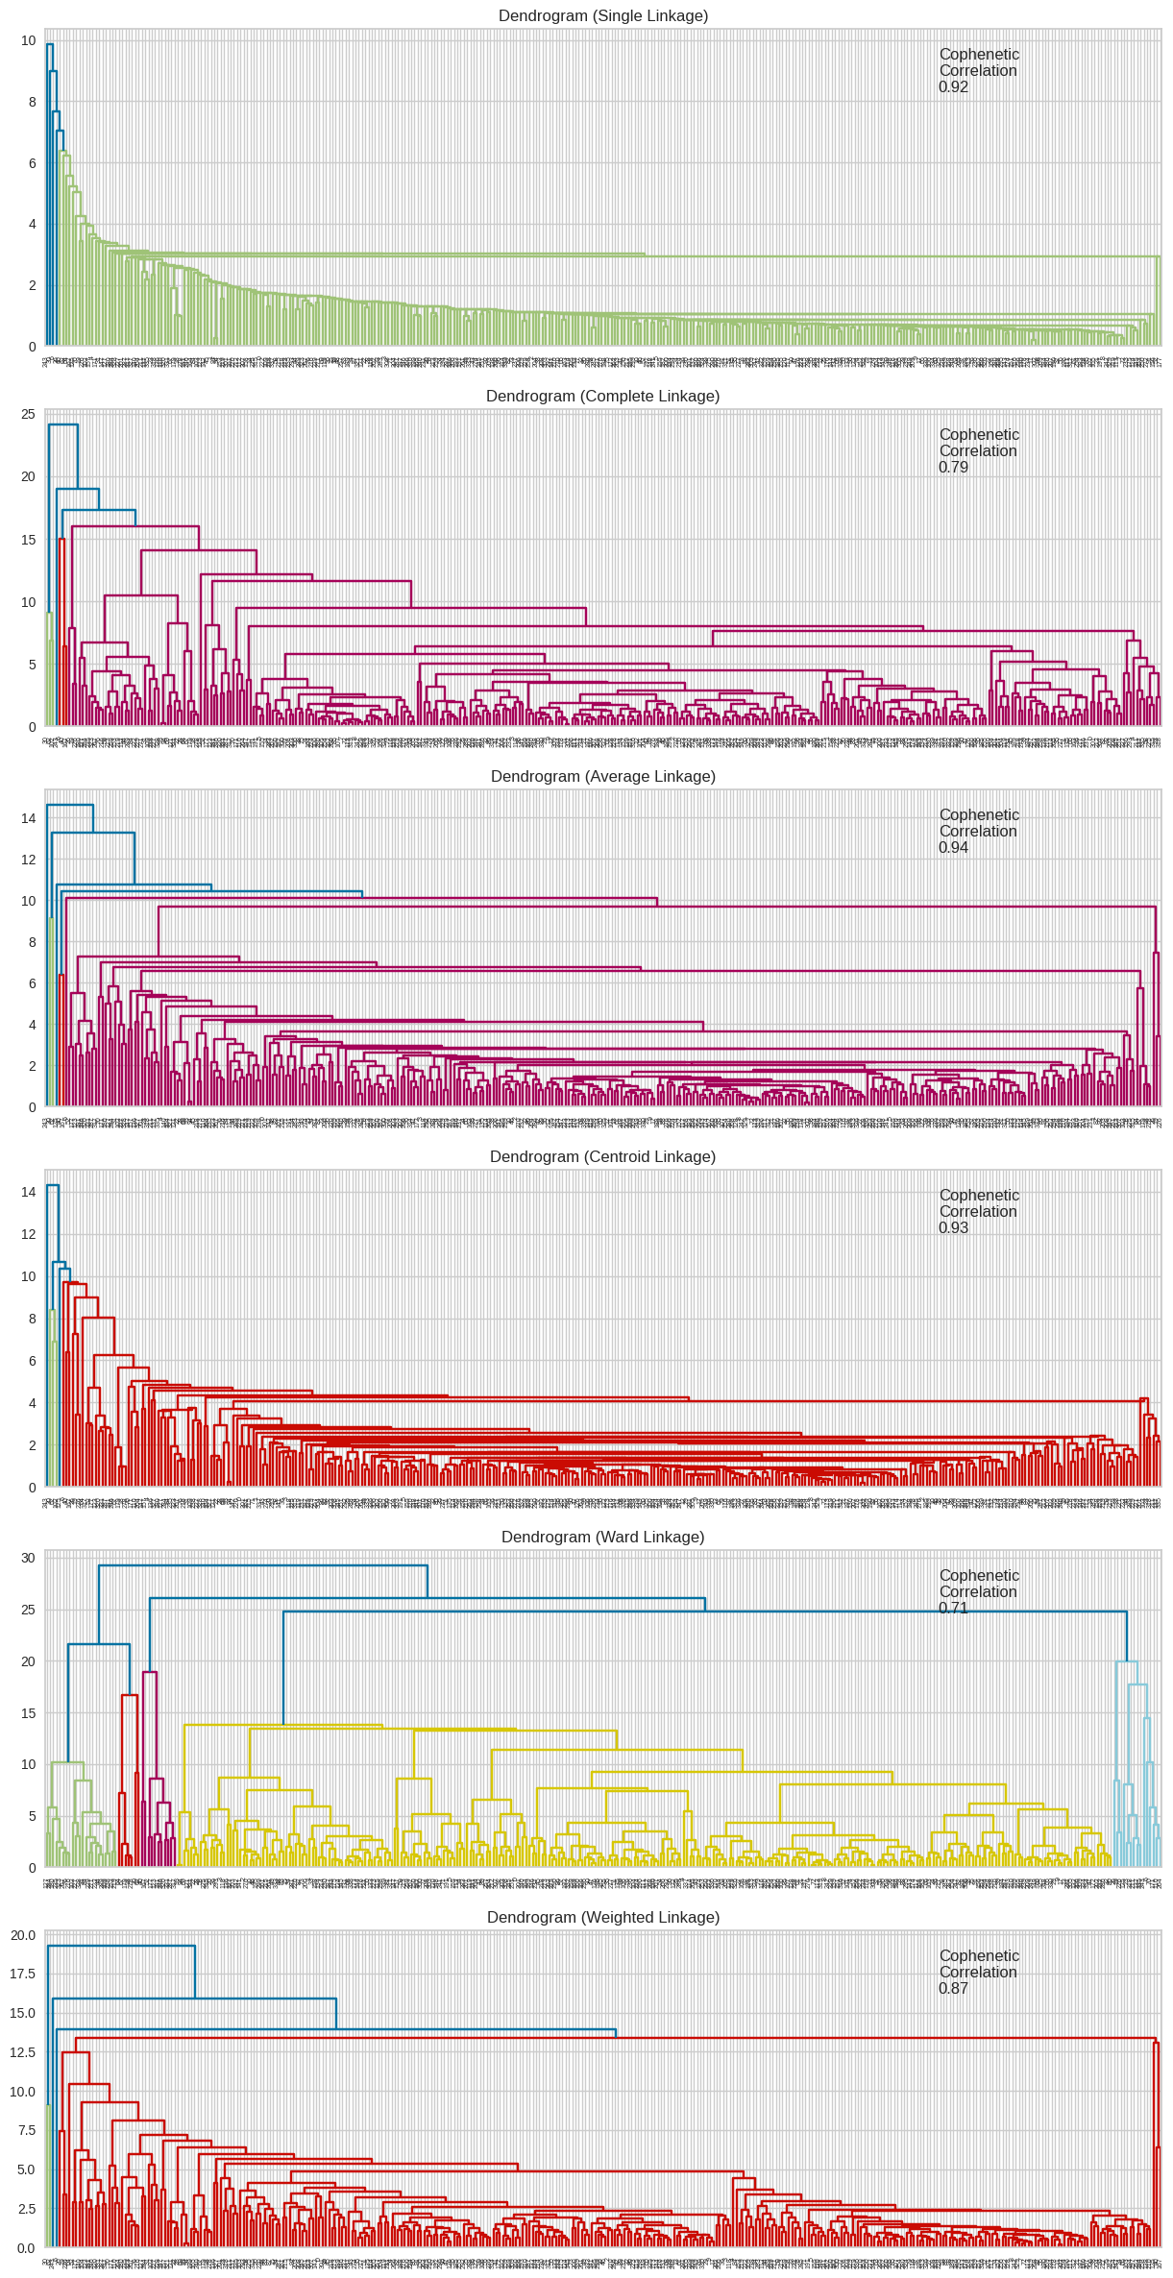
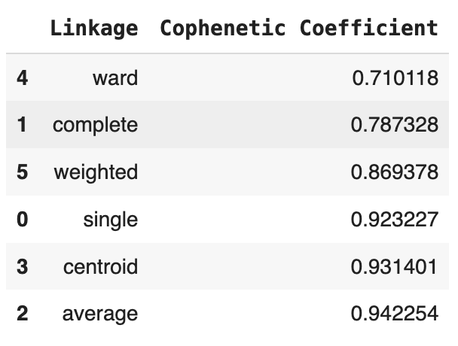
Hierarchical Clustering Technique: Cophenetic Correlation (2/2): Focus on Euclidean Distance
Highest cophenetic correlation with Euclidean distance is 0.94, which is obtained with average linkage
The cophenetic correlation with Euclidean distance is highest for average linkage (0.94).
With Euclidean Distance:
6 appears to be the appropriate number of clusters from the dendrogram for average linkage (At a distance of 10)
Average linkage has the highest cophenetic coefficient (0.94) whereas ward linkage has the least cophenetic coefficient (0.71)
We will however move ahead with ward linkage since it has the most distinct and separated clusters; from the dendrogram, 6 appears to be the appropriate number of clusters (just below a distance of 20)

Slide 37
K-Means vs Hierarchical Clustering
It took about 31s to display the dendrograms of the different linkage methods with the Euclidean distance whereas fitting of K-Means for different values of k was accomplished in milliseconds
As concerns the clustering performance of each technique:
Of the 13 values of K evaluated, the chosen number of clusters, 4, registered the second highest silhouette score (about 0.46)
Of the various linkage vs distance combinations evaluated for the hierarchical clustering, the chosen combination, ward linkage – Euclidean distance, registered a relatively low cophenetic score (0.71) but was chosen because, from the dendrogram, its clusters appeared to be the most distinct and separated; number of clusters chosen: 6
Certain observations on corresponding similar clusters across both techniques:
The smallest HC Segment (5) contains 11 companies whereas the smallest KM Segment (1) has 3 companies. They appear to perform best on different metrics: HC_Segment 5 performs best on Price Change, Cash Flow, and P/E Ratio whereas KM_Segment 1 on Net Income, Earnings Per Share, and Estimated Shares Outstanding
The largest HC Segment (3) contains 285 companies whereas the largest KM Segment (0) contains 277 companies. Both have low to medium performance on the various metrics
Intermediate size clusters obtained using each technique display varying levels of performance on the provided metrics

